Slide 1
A Degradation Parameter Observer for State of Health (SoH) Assessment of
Lithium-Ion Batteries
Co-Authors: M. S. Félix(1), J. J. Martinez(1), C. Bérenguer(1),
Chetan Kulkarni(2), Marcos Orchard(3)
(1)Université Grenoble Alpes, CNRS, Grenoble INP, GIPSA-Lab, Grenoble, France
(2)NASA Ames Research Center (KBR, Inc), Moffett Field, CA 94043, USA
(3)CASE - Univ. of Chile, Santiago, Chile
<number>

Slide 2
Outline
PART I: State of Health (SoH) Assessment of Lithium-Ion Batteries
Motivations
Problem statement
Design of the proposed state observer
Results
Conclusions
PART II: Example of integration in HAC decisions
Battery-powered application
Design of a chosen HAC approach
Results in a simulation study case
Conclusions
<number>

Slide 3
PART I: State of Health (SoH) Assessment of Lithium-Ion Batteries
Motivations
<number>

Slide 4
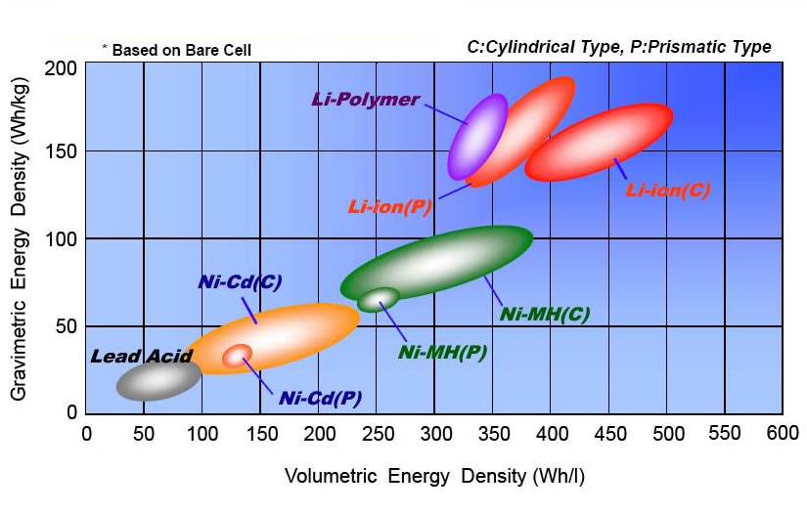
Lithium-Ion Batteries
Energy density for different types of battery
(1)
Li-ion offers advantage compared to other technologies
Azais, P., Bardet, M., Billy, E., Colin, J. F., Dauchy, J., Despesse, G., ... & Simone, V. (2020). Li-ion batteries. From the present to the future.
<number>
Notes:
lithium-ion batteries have become the standard due to their high energy density, light weight, and rechargeability. Revolutionating electronics industry with portable devices and electrical industry with battery-powered operation such as transport and energy production and storage

Slide 5
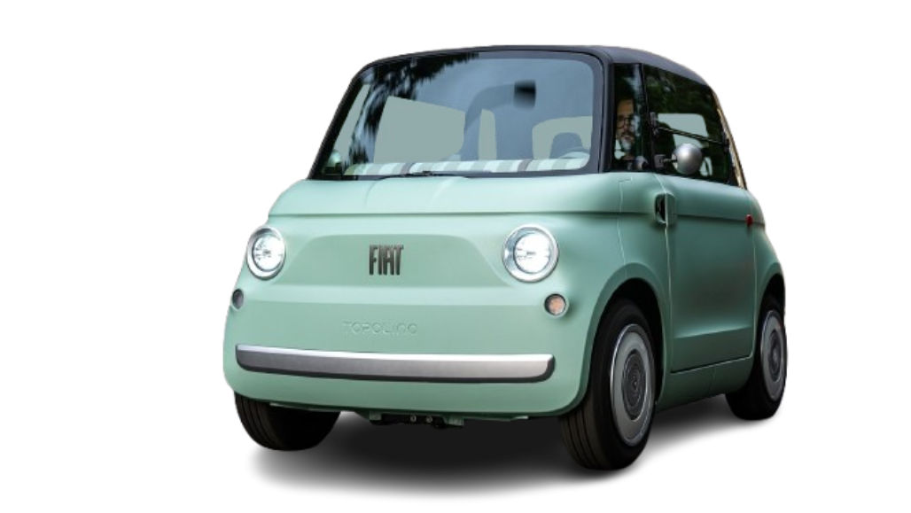
Lithium-Ion Batteries
Energy density for different types of battery
(1)
a revolution in the electronics and electrical industries
Battery is now the most important component in many electrical systems!
Azais, P., Bardet, M., Billy, E., Colin, J. F., Dauchy, J., Despesse, G., ... & Simone, V. (2020). Li-ion batteries. From the present to the future.
<number>
Notes:
lithium-ion batteries have become the standard due to their high energy density, light weight, and rechargeability. Revolutionating electronics industry with portable devices and electrical industry with battery-powered operation such as transport and energy production and storage

Slide 6
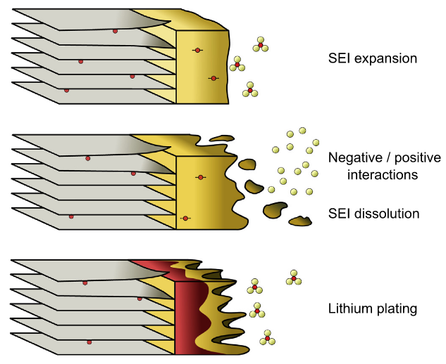
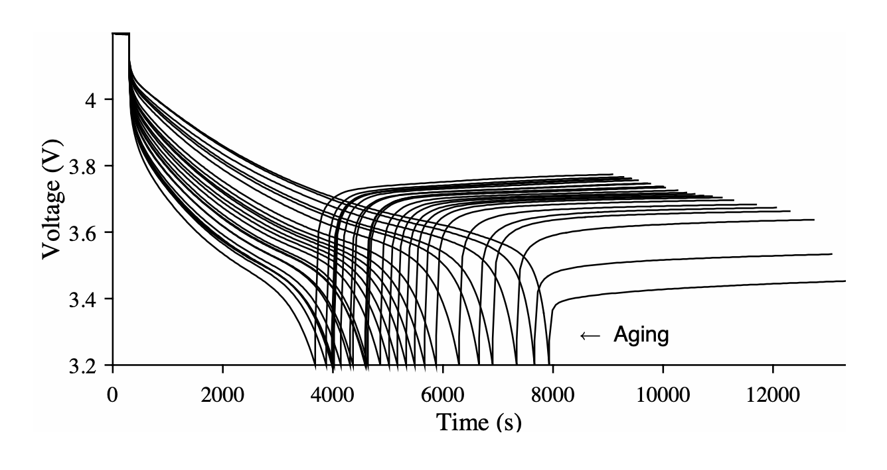
Degradation during lifetime usage
Physico-chemical reactions
Changes in electrical behavior
(1)
(2)
Degradation means operation, environmental and safety cost
SEI : solid electrolyte interphase
Barré, A., Deguilhem, B., Grolleau, S., Gérard, M., Suard, F., & Riu, D. (2013). A review on lithium-ion battery ageing mechanisms and estimations for automotive applications. Journal of power sources, 241, 680-689.
Kulkarni, C. S., & Daigle, M. (2016). End-of-Discharge and End-of-Life Prediction in Lithium-Ion Batteries with Electrochemistry-Based Aging Models.
<number>
Notes:
Lthium-ion battery degradation is a complex phenomenon that directly impacts various costs—operational, environmental, and safety. Here's how they are interlinked:
1. Battery Degradation and Operational Cost
Efficiency Loss: Over time, battery degradation reduces capacity and energy efficiency. This means:
Increased energy consumption for the same output, raising electricity bills in applications like electric vehicles or grid storage.
More frequent charging cycles, leading to higher downtime and reduced productivity in industrial systems.
Replacement Costs: Degraded batteries need replacement sooner, increasing capital expenditure.
2. Battery Degradation and Environmental Cost
Use of Rare Materials: Degradation often leads to the extraction and processing of more rare materials (like lithium, cobalt, and nickel) to produce replacement batteries. This contributes to:
Mining Impacts: Environmental damage, habitat destruction, and high carbon emissions from mining operations.
Waste Management: End-of-life batteries add to e-waste. If not properly recycled, they can leach toxic chemicals into the environment.
Resource Depletion: The need to frequently replace degraded batteries accelerates the depletion of finite resources.
3. Battery Degradation and Safety Cost
Overheating Risks: Degraded batteries often suffer from internal resistance buildup, increasing the likelihood of overheating, especially during high-demand applications.
Thermal Runaway: This overheating can lead to thermal runaway events, causing fires or explosions, which pose significant safety risks.
Preventive Measures: Additional costs arise from implementing safety systems like cooling mechanisms or advanced monitoring to mitigate these risks.

Slide 7
State of Health definition
The deviation of the battery's condition or performance from its nominal condition
is represented by the State of Health.
old
new
<number>
Notes:
Lthium-ion battery degradation is a complex phenomenon that directly impacts various costs—operational, environmental, and safety. Here's how they are interlinked:
1. Battery Degradation and Operational Cost
Efficiency Loss: Over time, battery degradation reduces capacity and energy efficiency. This means:
Increased energy consumption for the same output, raising electricity bills in applications like electric vehicles or grid storage.
More frequent charging cycles, leading to higher downtime and reduced productivity in industrial systems.
Replacement Costs: Degraded batteries need replacement sooner, increasing capital expenditure.
2. Battery Degradation and Environmental Cost
Use of Rare Materials: Degradation often leads to the extraction and processing of more rare materials (like lithium, cobalt, and nickel) to produce replacement batteries. This contributes to:
Mining Impacts: Environmental damage, habitat destruction, and high carbon emissions from mining operations.
Waste Management: End-of-life batteries add to e-waste. If not properly recycled, they can leach toxic chemicals into the environment.
Resource Depletion: The need to frequently replace degraded batteries accelerates the depletion of finite resources.
3. Battery Degradation and Safety Cost
Overheating Risks: Degraded batteries often suffer from internal resistance buildup, increasing the likelihood of overheating, especially during high-demand applications.
Thermal Runaway: This overheating can lead to thermal runaway events, causing fires or explosions, which pose significant safety risks.
Preventive Measures: Additional costs arise from implementing safety systems like cooling mechanisms or advanced monitoring to mitigate these risks.

Slide 8
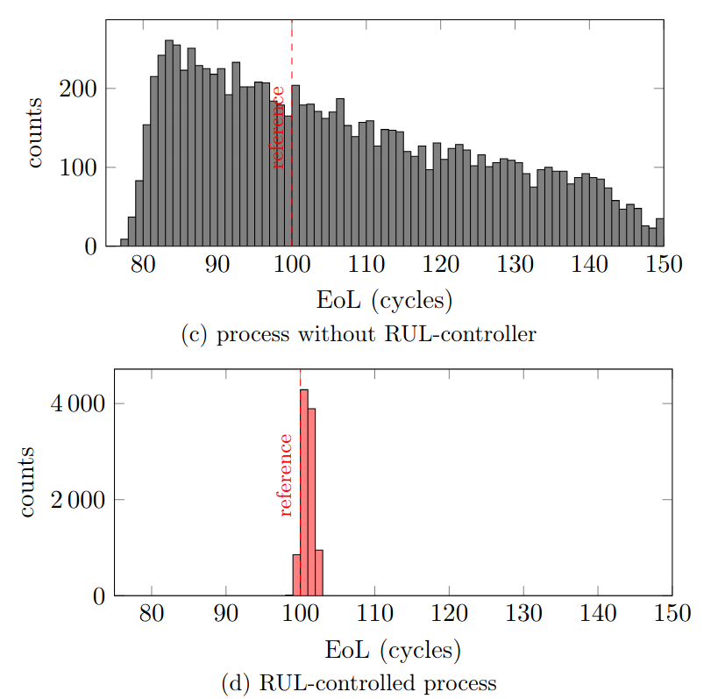
Why State of Health (SoH) Assessment is so important?
Resulted End-of-Life (EoL)
Open-loop degradation
Managed degradation
Informed decisions → allow to anticipate actions
Informed decisions → allow to anticipate actions → Change EoL result
Félix, M. S., Martinez, J. J., & Bérenguer, C. (2023). A state-space approach for remaining useful life control. IFAC-PapersOnLine, 56(2), 7728-7733.
<number>
Notes:
Example of proactive decision-making:
Prescriptive Maintenance: integrating maintenance recommendations in operation decisions
Health-aware Control: controlling the operation considering health objectives/costs
Informed decision-making, rooted in robust data analysis and predictive insights, enhances an organization's capacity to adapt. By anticipating future events and conditions, proactive strategies can be devised to optimize performance, reduce risks, and ensure sustainability.
Example of Proactive Decision-Making
Prescriptive Maintenance: Leveraging predictive analytics to not only forecast equipment failures but also recommend optimal actions. This minimizes downtime, extends the life of assets, and ensures efficient resource allocation.
Health-aware Control: Integrating system health data into control algorithms allows for dynamic adjustments to operating conditions. This ensures that performance is optimized while considering the system's remaining useful life, thus balancing efficiency and longevity.
Both approaches exemplify how proactive, informed decision-making can drive adaptability in dynamic environments.

Slide 9
Why State of Health (SoH) Assessment is so important?
Resulted End-of-Life (EoL)
Open-loop degradation
Useful in different applications:
Prescriptive Maintenance
Health-aware Control
Managed degradation
Informed decisions → allow to anticipate actions → Change EoL result
Félix, M. S., Martinez, J. J., & Bérenguer, C. (2023). A state-space approach for remaining useful life control. IFAC-PapersOnLine, 56(2), 7728-7733.
<number>
Notes:
Example of proactive decision-making:
Prescriptive Maintenance: integrating maintenance recommendations in operation decisions
Health-aware Control: controlling the operation considering health objectives/costs
Informed decision-making, rooted in robust data analysis and predictive insights, enhances an organization's capacity to adapt. By anticipating future events and conditions, proactive strategies can be devised to optimize performance, reduce risks, and ensure sustainability.
Example of Proactive Decision-Making
Prescriptive Maintenance: Leveraging predictive analytics to not only forecast equipment failures but also recommend optimal actions. This minimizes downtime, extends the life of assets, and ensures efficient resource allocation.
Health-aware Control: Integrating system health data into control algorithms allows for dynamic adjustments to operating conditions. This ensures that performance is optimized while considering the system's remaining useful life, thus balancing efficiency and longevity.
Both approaches exemplify how proactive, informed decision-making can drive adaptability in dynamic environments.

Slide 10
Literature review in SoH assessment
SoH assessment
Offline approaches
good accuracy
<number>

Slide 11
Literature review in SoH assessment
SoH assessment
real-time decisions
Offline approaches
Online approaches
Safety
indicator
Autonomy
indicator
<number>

Slide 12
Literature review in SoH assessment
SoH assessment
Offline approaches
Online approaches
Safety
indicator
Autonomy
indicator
Motivation:
Health-informed real-time decisions
for RUL control
Our proposition:
Both
indicators
Online estimations of SoH while including both autonomy and safety,
using a state observer, which accepts different initial conditions and is well suited for online estimations!
<number>

Slide 13
Problem statement
<number>

Slide 14
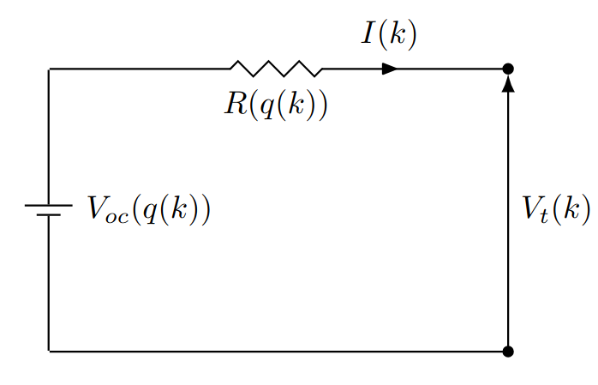
Battery modeling
Simple battery
equivalent circuit model
Terminal voltage
depends on SoC
A model is required to represent the battery behavior
Plett, G. L. (2015). Battery management systems, Volume II: Equivalent-circuit methods. Artech House.
Pelletier, S., Jabali, O., Laporte, G., & Veneroni, M. (2017). Battery degradation and behaviour for electric vehicles: Review and numerical analyses of several models. Transportation Research Part B: Methodological, 103, 158-187.
<number>

Slide 15
Battery modeling
Simple battery
equivalent circuit model
Terminal voltage
loss of energy
A model is required to represent the battery behavior
Plett, G. L. (2015). Battery management systems, Volume II: Equivalent-circuit methods. Artech House.
Pelletier, S., Jabali, O., Laporte, G., & Veneroni, M. (2017). Battery degradation and behaviour for electric vehicles: Review and numerical analyses of several models. Transportation Research Part B: Methodological, 103, 158-187.
<number>

Slide 16
Battery modeling
Terminal voltage
Simple battery
equivalent circuit model
State-of-charge (SoC)
Coulomb counting
capacity of storage
A model is required to represent the battery behavior
Plett, G. L. (2015). Battery management systems, Volume II: Equivalent-circuit methods. Artech House.
Pelletier, S., Jabali, O., Laporte, G., & Veneroni, M. (2017). Battery degradation and behaviour for electric vehicles: Review and numerical analyses of several models. Transportation Research Part B: Methodological, 103, 158-187.
<number>

Slide 17
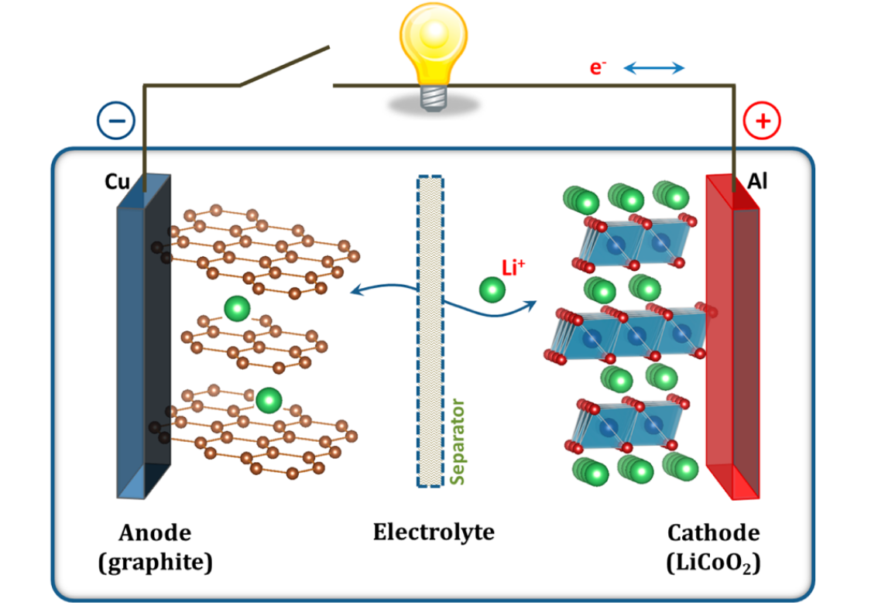
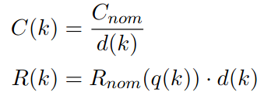
Modeling degraded behavior
Capacity and resistance changes as a function of degradation
less energy stored
more resistance
(loss of energy)
resistance
energy stored
<number>

Slide 18
Modeling degraded behavior
Capacity and resistance changes in function of a degradation parameter
Final proposed model
resistance
energy stored
Parameter d updates the dynamics according to degradation
<number>

Slide 19
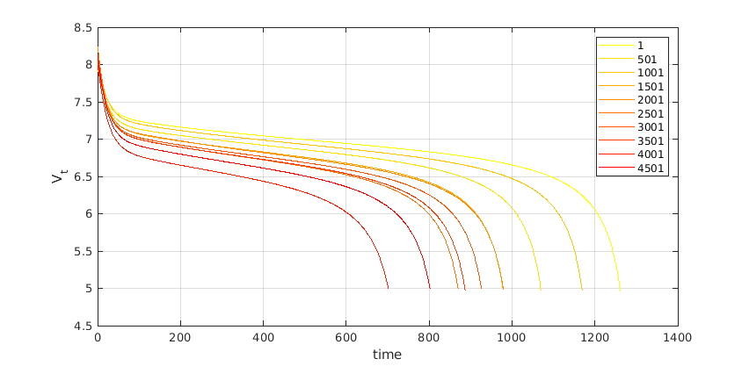
Example of degraded behavior simulation
no cycle
Terminal
voltage
seconds
Simulation results shows ability of chosen model to represent battery’s degraded behavior
<number>

Slide 20
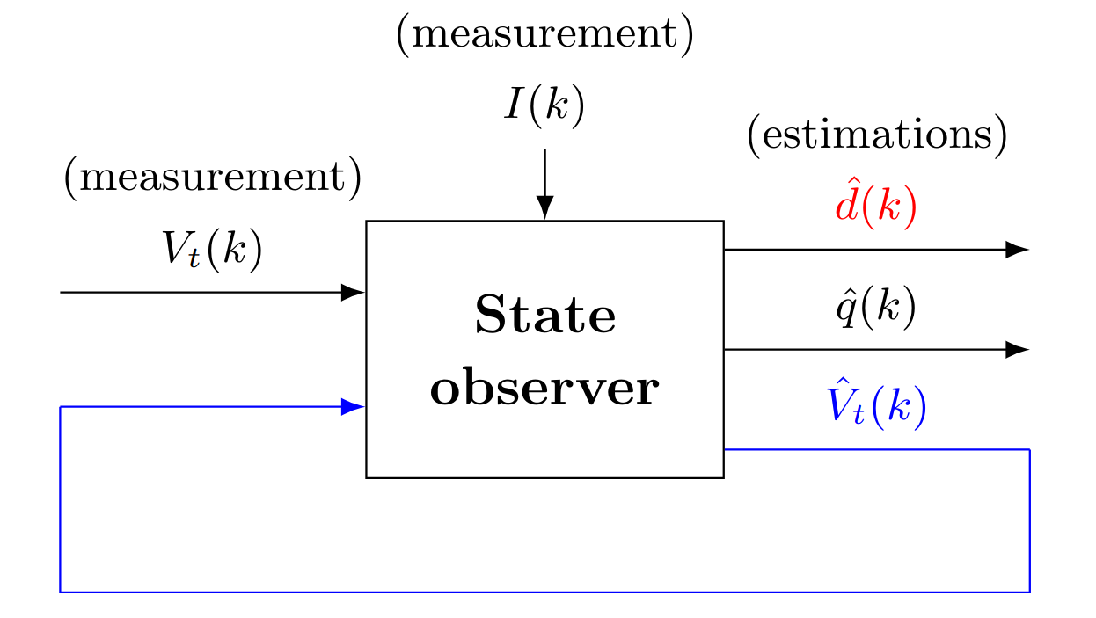
Proposition for SoH assessment approach
Using available measurement to correct electrical behavior estimation
including updates on degradation parameter
<number>

Slide 21
Design of the state observer
<number>

Slide 22
Estimation of battery dynamics using robust state observer
LPV Modeling
states to be estimated
electrical and degradation behavior both estimated
<number>

Slide 23
Estimation of battery dynamics using robust state observer
LPV Modeling
states to be estimated
electrical and degradation behavior both estimated
output measurements
only voltage is measured
<number>

Slide 24
Estimation of battery dynamics using robust state observer
LPV Modeling
states to be estimated
output measurements
System matrices
system
varying parameters
<number>

Slide 25
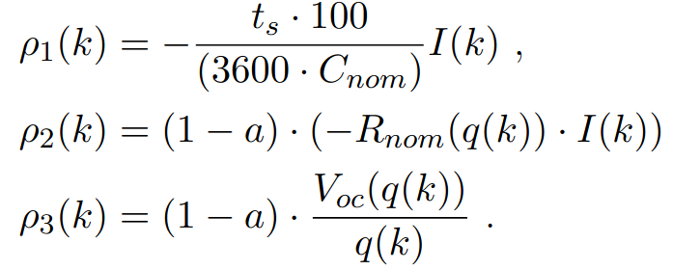
Estimation of battery dynamics using robust state observer
LPV Modeling
states to be estimated
output measurements
System matrices
varying parameters
depends on current (measured)
and SoC (estimated)
<number>

Slide 26
Functions for nominal resistance and open-circuit voltage
Chosen functions:
remains the same, but the SoC dynamics suffer with degradation
Resulted of identification of parameters for a 1 healthy (new) battery pack:
It could be represented by other functions, such as polynomial functions.
<number>

Slide 27
Estimation of battery dynamics using robust state observer
LPV Modeling
states to be estimated
output measurements
System matrices
corrections using electrical measurements
State observer estimations
Find the optimal and robust L that stabilizes the system for all points of the LPV model!
<number>

Slide 28
Find robust observer gain L: polytopic approach
A polytopic approach refers to modeling uncertain or nonlinear systems using a convex polytope to describe the system's dynamics.
A convex polytope is a geometric shape defined by a finite set of vertices or linear inequalities.
<number>

Slide 29
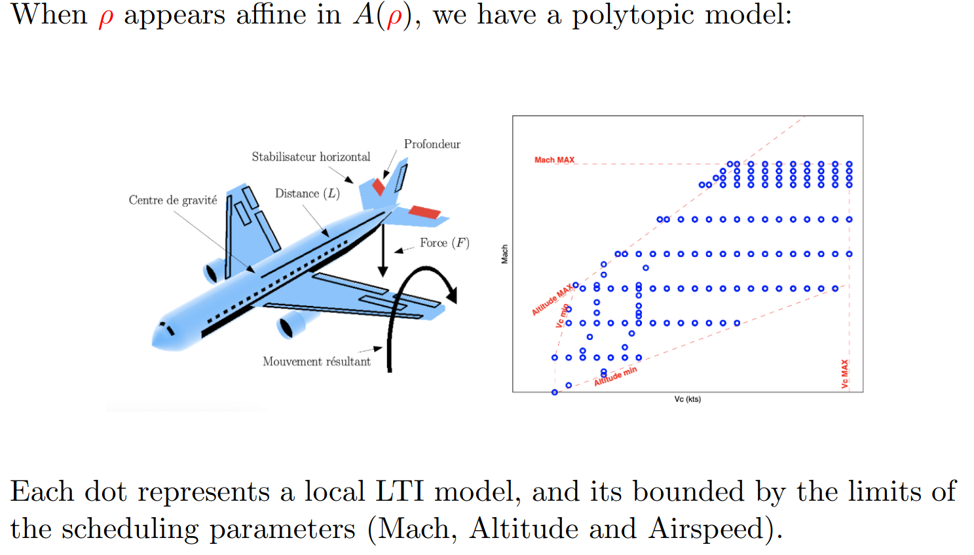
Find robust observer gain L: polytopic approach
A polytopic approach refers to modeling uncertain or nonlinear systems using a convex polytope to describe the system's dynamics.
A convex polytope is a geometric shape defined by a finite set of vertices or linear inequalities.
Each dot represents a local LTI model in function of scheduling parameters. The polytope is defined by limits of the scheduling parameters (Mach, Altitude and Airspeed).
Atoui, H., Sename, O., Milanés, V., & Martinez, J. J. (2021). LPV-based autonomous vehicle lateral controllers: A comparative analysis. IEEE Transactions on Intelligent Transportation Systems, 23(8), 13570-13581.
<number>

Slide 30
Find robust observer gain L: polytopic approach
A polytopic approach refers to modeling uncertain or nonlinear systems using a convex polytope to describe the system's dynamics.
A convex polytope is a geometric shape defined by a finite set of vertices or linear inequalities.
Each dot represents a local LTI model in function of scheduling parameters. The polytope is defined by limits of the scheduling parameters (Mach, Altitude and Airspeed).
Necessary and sufficient to guarantee stability in the vertices of the polytope.
<number>

Slide 31
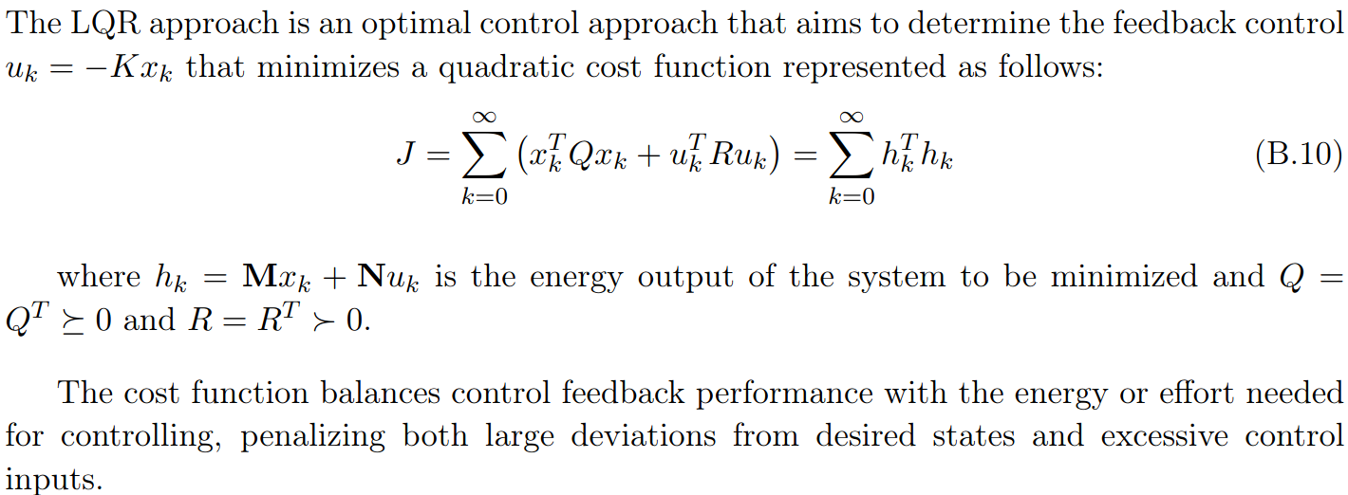
Robust observer formulation
Based on Linear Quadratic-Regulator (LQR) problem
<number>

Slide 32
Robust observer formulation
Based on Linear Quadratic-Regulator (LQR) problem
Adapted to the estimation problem instead of regulation
Find optimal and robust L
that stabilizes the system in every vertice of the polytope defined by the LPV model!
<number>

Slide 33
Robust observer formulation
Based on Linear Quadratic-Regulator (LQR) problem
Adapted to the estimation problem instead of regulation
Find optimal and robust L
that stabilizes the system in every vertice of the polytope defined by the LPV model!
Reformulated as Linear Matrix Inequality (LMI) form
solved using numerical algorithms
<number>

Slide 34
Results I: simulation data
<number>

Slide 35
Degradation rate model for increase simulation
random parameter
Joule’s effect
SoC and current depends on the operation
*Joule's first law: relationship between the heat generated and the current flowing through a conductor
<number>

Slide 36
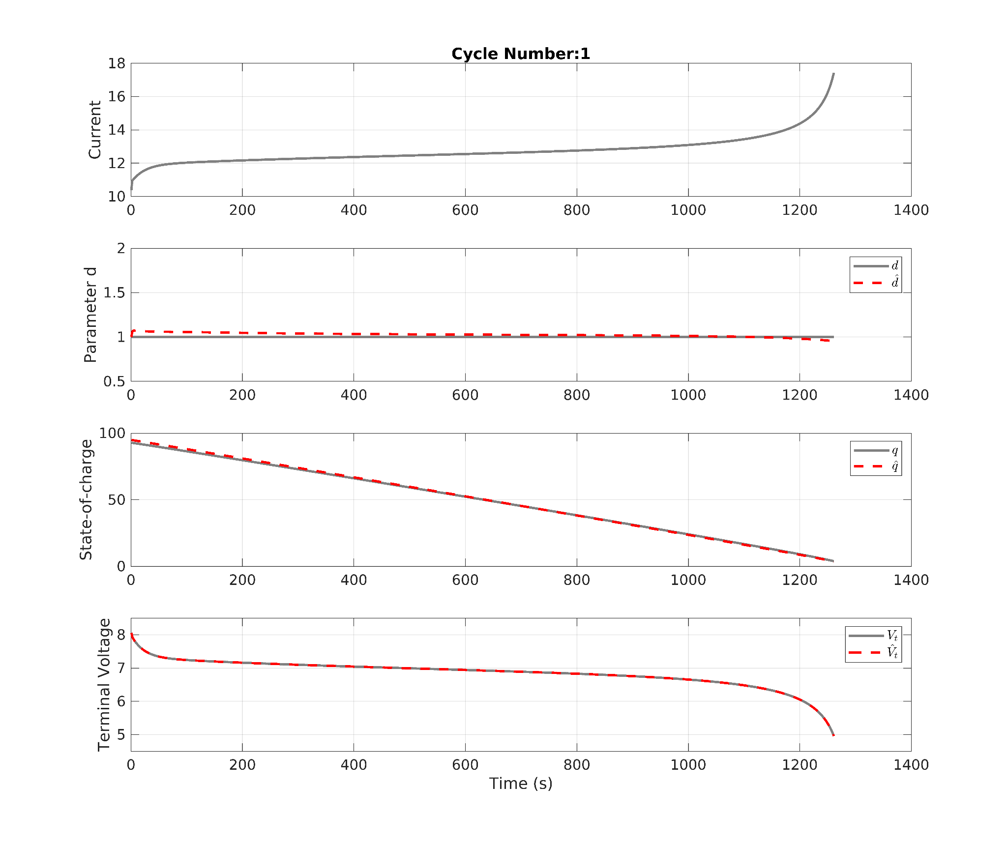
Estimation results during discharging
early life cycle
<number>

Slide 37
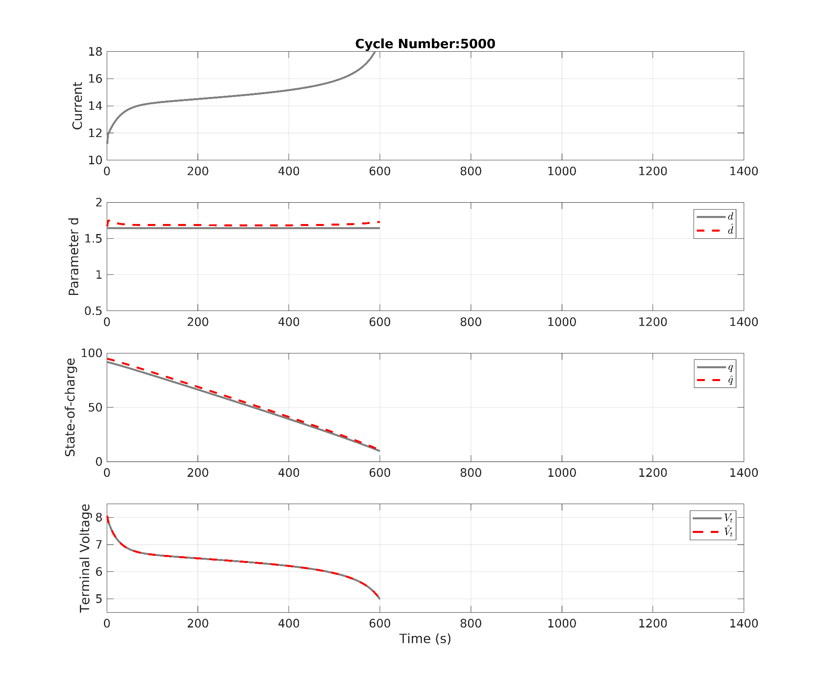
Estimation results during discharging after 5000 cycles
early life cycle
late life cycle
Both electrical and degradation states are estimated for different levels of degradation
<number>

Slide 38
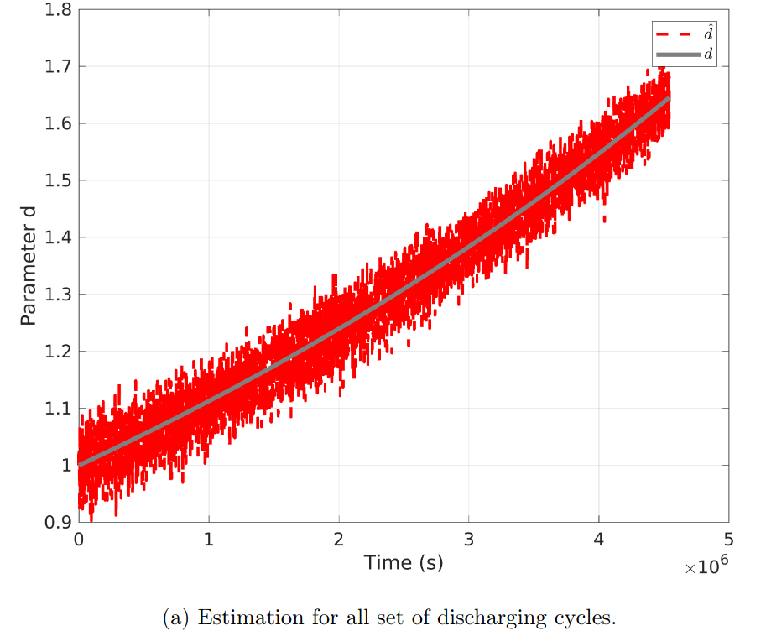
Estimation results during discharging over the 5000 cycles
<number>

Slide 39
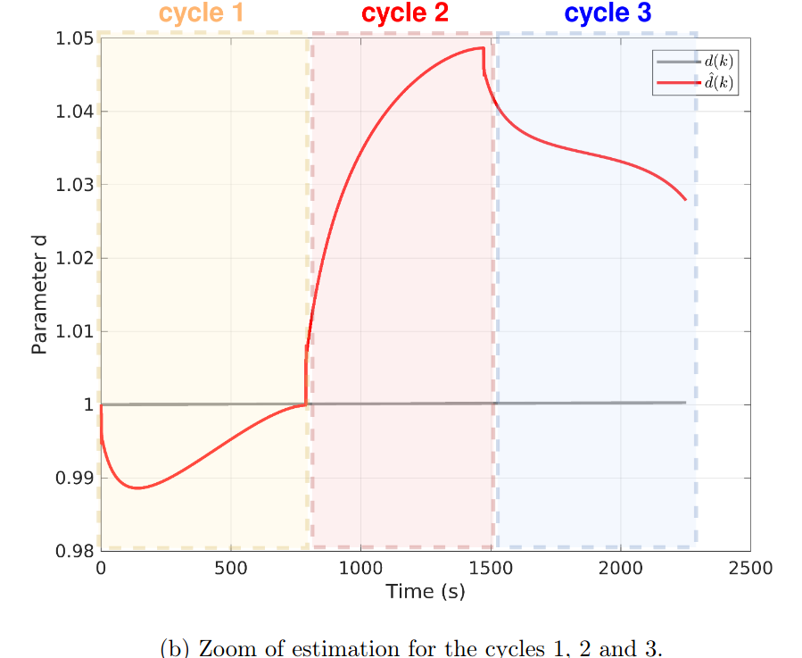
Estimation results during discharging over the 5000 cycles
zoom
Some fluctuations on the estimation behavior are noticed
<number>

Slide 40
Results II: experimental data
<number>

Slide 41
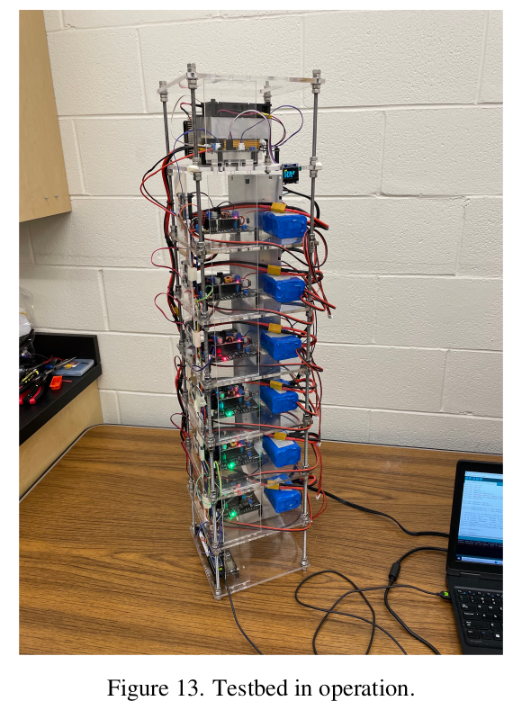
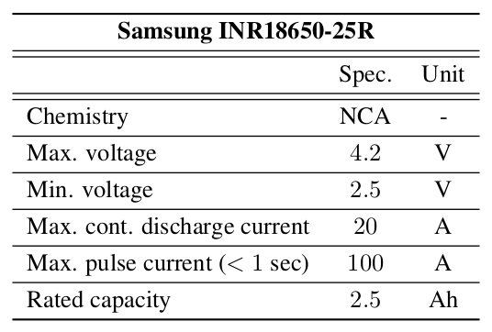
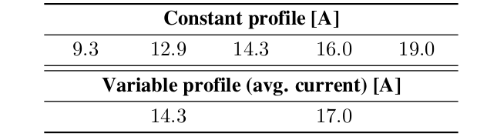
Experimental case: Battery pack with 2 cells in series
Test set
Industrial cell characteristics
Different sets of discharge profile
Available data: Current, temperature and terminal voltage.
Fricke, K., Nascimento, R., Corbetta, M., Kulkarni, C., & Viana, F. (2023). An accelerated life testing dataset for lithium-ion batteries with constant and variable loading conditions. International Journal of Prognostics and Health Management, 14(2).
<number>

Slide 42
Experimental case: Battery pack with 2 cells in series
Test set
Industrial cell characteristics
Different sets of discharge profile
chosen
Available data: Current, temperature and terminal voltage.
Fricke, K., Nascimento, R., Corbetta, M., Kulkarni, C., & Viana, F. (2023). An accelerated life testing dataset for lithium-ion batteries with constant and variable loading conditions. International Journal of Prognostics and Health Management, 14(2).
<number>

Slide 43
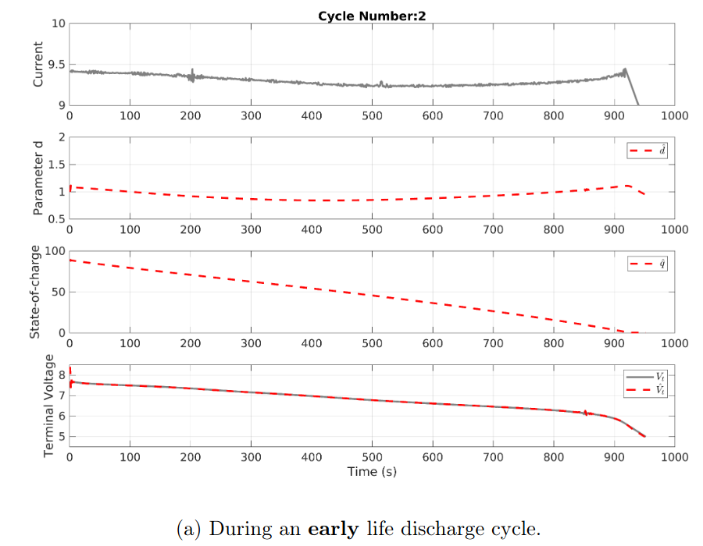
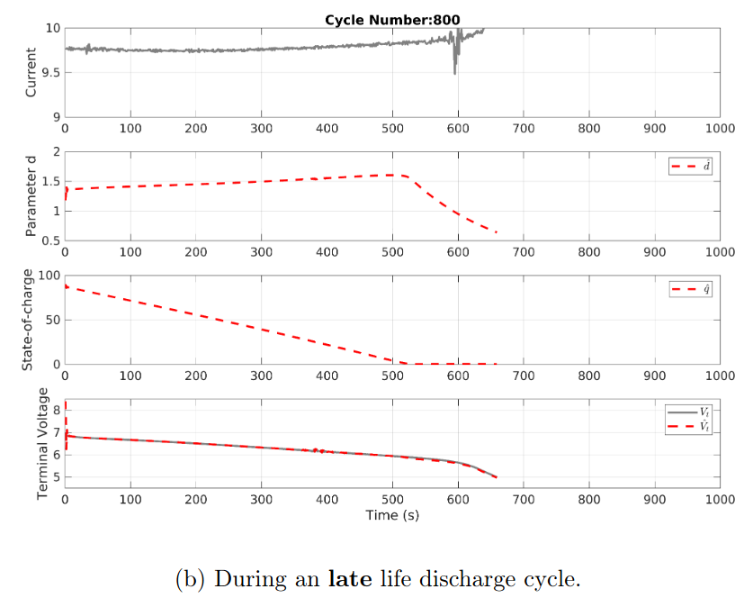
Experimental case: Nasa dataset 2 cells in series
Experimental case: Battery pack with 2 cells in series
Both electrical and degradation states are estimated for different levels of degradation
even under measurements noise
<number>

Slide 44
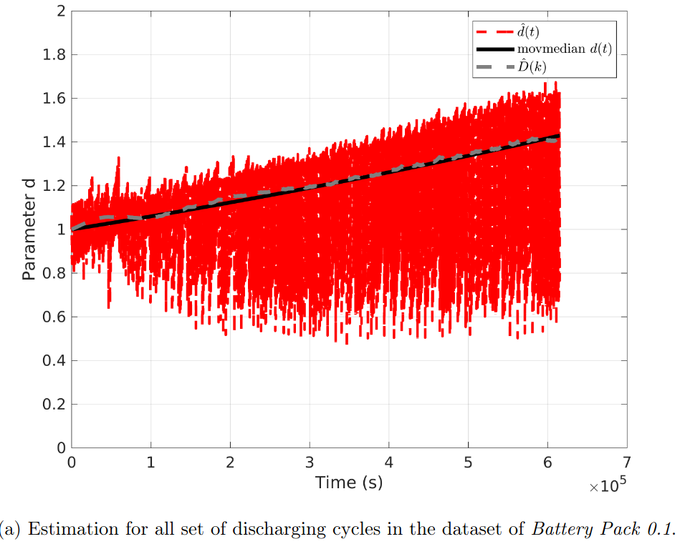
Experimental case: Nasa dataset 2 cells in series
Experimental case: Battery pack with 2 cells in series
For all set of discharging
<number>

Slide 45
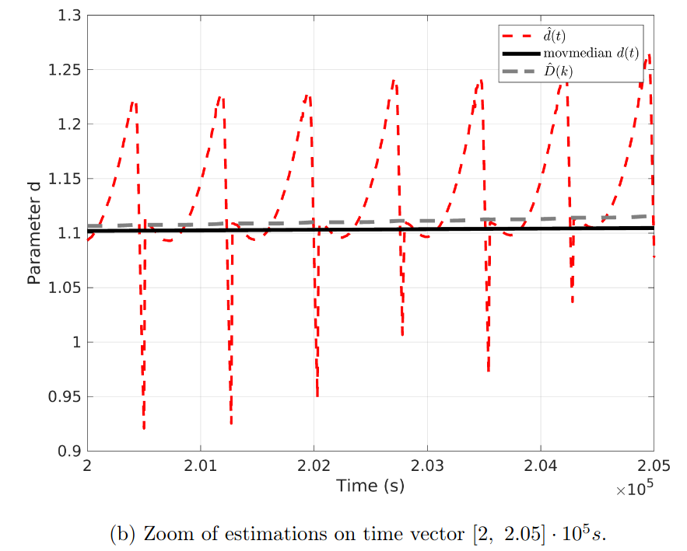
Experimental case: Nasa dataset 2 cells in series
Experimental case: Battery pack with 2 cells in series
Degradation level is updated, but fluctuations increased especially in the begin and the end of discharge
Possible solution: Post-processing phase to extract continuous part
<number>

Slide 46
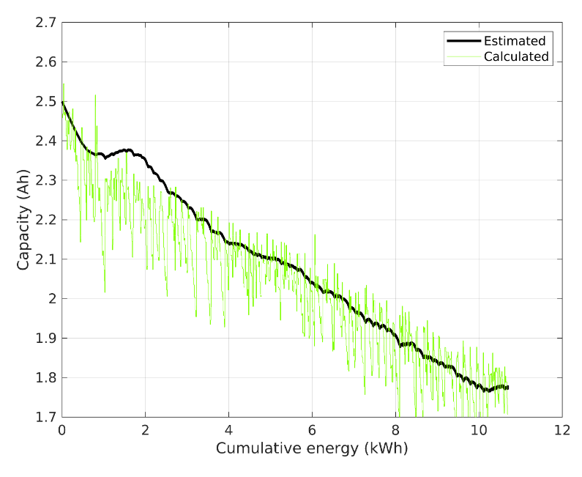
Validation of results
Degradation is unknown so we validate with capacity decrease calculated at end of each discharge cycle.
Estimated + filtered (black)
vs.
Calculated offline (green)
Filtered estimation follows the average capacity decrease.
<number>

Slide 47
PART I : Conclusions
Conclusion:
State observers allow online estimations even if the degradation model is not available.
A robust approach allows uncertain modeling.
Some fluctuations are unavoidable since degradation increase is very slow.
Some post-processing may be required.
Future perspective:
Estimation considers charging operation.
Improve estimation fluctuations through better identification and preprocessing phase.
Compare with classical methods (e.g., Extended Kalman Filtering).
Implement with RUL control.
Include prognostics.
<number>

Slide 48
PART II: Illustration of application in HAC decisions
How to use such estimations to make decisions?
<number>

Slide 49
Presentation of battery-powered example of application
<number>

Slide 50
Example of application: Vehicle-to-Grid
Relevance:
EVs can be used for Battery Energy Storage Systems (BESS)
EV owners can pay back their investment
drawback: overcycling batteries
Discharging/selling energy operation degrades EV battery
<number>

Slide 51
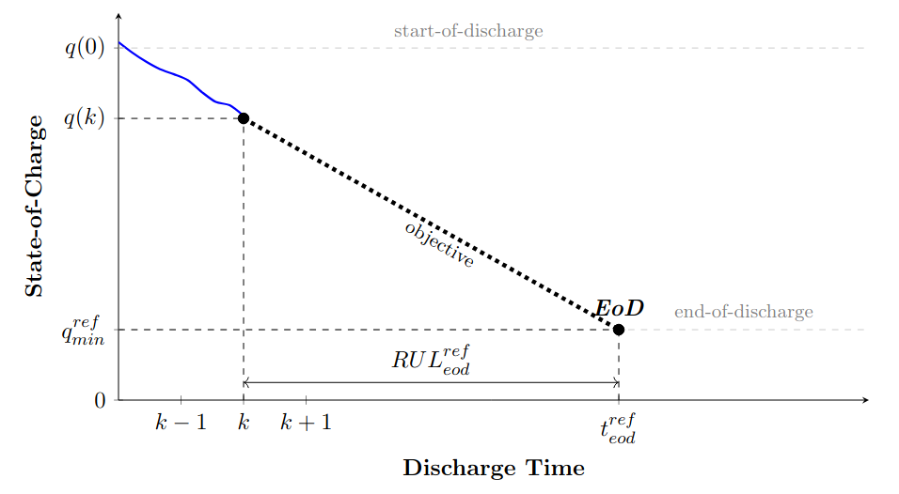
Problem statement: V2G integrated with control of end-of-discharge
End-of-discharge defined by minimum SoC and time-of-discharge
remark: Discharging profile drives degradation increase
<number>

Slide 52
Design of a chosen HAC approach
<number>

Slide 53
End-of-discharge control
user
grid
Minimum SoC and maximum time-of-discharge defined by the user
<number>

Slide 54
End-of-discharge control +RUL control
Minimum SoC and maximum time-of-discharge defined by the user
Minimum SoC re-adjusted according to EoL objectives
remark: SoC also plays on the battery degradation increase
<number>

Slide 55
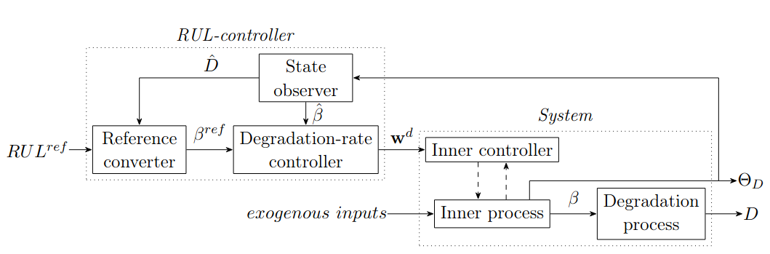
Control framework implementation
(1)
degradation
indicator
State-space framework design
Requires estimations of degradation indicator
Félix, M. S., Martinez, J. J., & Bérenguer, C. (2023). A state-space approach for remaining useful life control. IFAC-PapersOnLine, 56(2), 7728-7733.
<number>

Slide 56
Simulation results
<number>

Slide 57
End-of-Discharge control results for 1500 usage events
desired
Without EoD control
resulted
Resulting discharge end for n cycles earlier than user defined.
This error increases with the increased degradation
<number>

Slide 58
End-of-Discharge control results for 1500 usage events
desired
Without EoD control
resulted
desired = resulted
With EoD control
EoD control corrects error between desired and resulted time-of-discharge
even under disturbances of degradation
<number>

Slide 59
Example of End-of-Discharge control + RUL control results
Degradation
increase
EoL reference
SoC minimum corrections changes the degradation trajectory
<number>

Slide 60
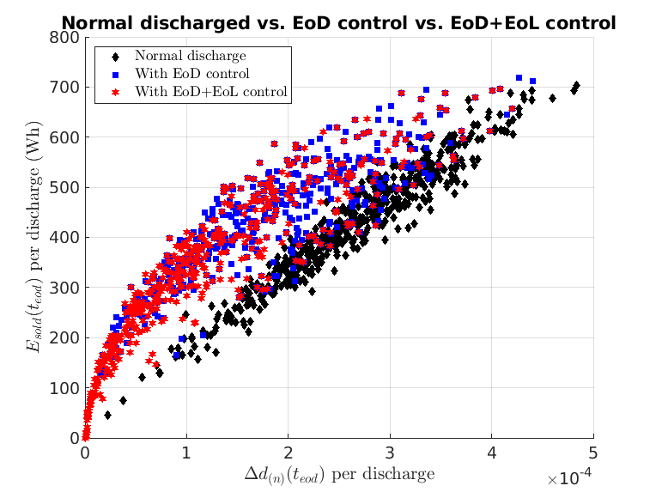
RESULTS ON DEGRADATION COST
EoD control (blue) allows the sale of the same energy with less degradation cost.
Energy
sold
Degradation Cost!
<number>

Slide 61
RESULTS ON DEGRADATION COST
EoD control (blue) allows the sale of the same energy with less degradation cost.
With the addition of RUL control (red), the chosen strategy decreased sold energy but gained in degradation cost.
Energy
sold
Degradation Cost!
EoD control improved performance-degradation balance
<number>

Slide 62
PART II : Conclusions
Conclusion:
Health-aware control can improve V2G applications.
Two strategies of HAC are compared, one adjusts the operation profile and other the reference.
EoD control that re-adjusts discharge profile obtained better performance-degradation balance.
EoL control that re-adjusts EoD reference does not change how discharge occurs; but it corrects the degradation final cost.
Together EoL+EoD control presents as a RUL control solution.
Future perspective:
Implement EoL control strategy with other decision variable.
Apply for another type of EoL control strategy (e.g., redundant energy source).
Include EV dynamic behavior.
Other decision-making applications (e.g., drones, electric bikes, etc.).
Overall conclusions:
The dynamic parameter allows a more straightforward implementation of control decisions.
A state-space framework is possible under robust approaches if the degradation model is uncertain.
<number>

Slide 63
Thank you for your attention !! Questions?
<number>

